Slide 1
PXIe4163 autorange issue
Onezhenji
2023.1.06

Slide 2
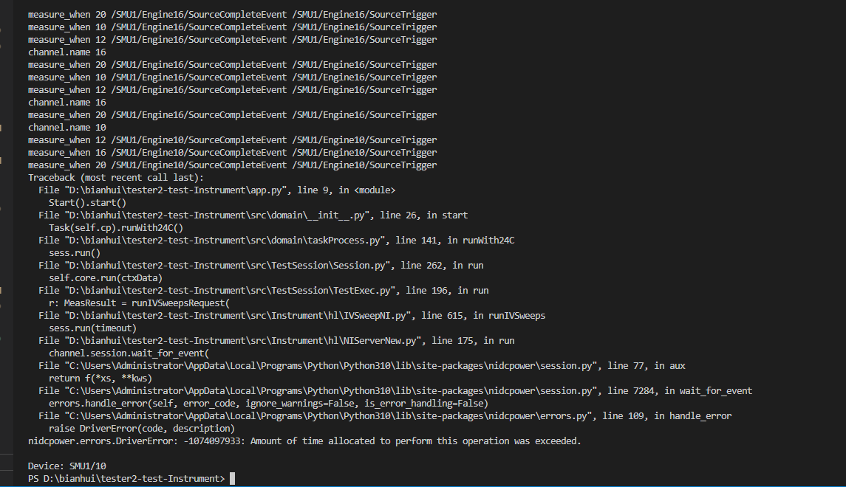
现象描述
✔ PXIe-4163 空跑（不连接DUT）电压sequence，能够持续运行，不会报错；
✔ PXIe-4163 连接DUT跑电压sequence，但是设置固定量程，不会报错；
× PXIe-4163 autorange，连接DUT跑电压sequence，会报超时错误。

Slide 3
我们的设置
1. I use python and "nidcpower" library to control my PXIe-4163;
2. For each test, I set one channel to be master and the 3 others to be slaves and set the input terminal of the Measure Trigger of the slaves to be the master device's Source Complete event;
On the slave device(s), the source trigger is the exported source trigger from the master device. (same settings as nidcpower example);
3. Set all channels in use to Auto_range;

Slide 4
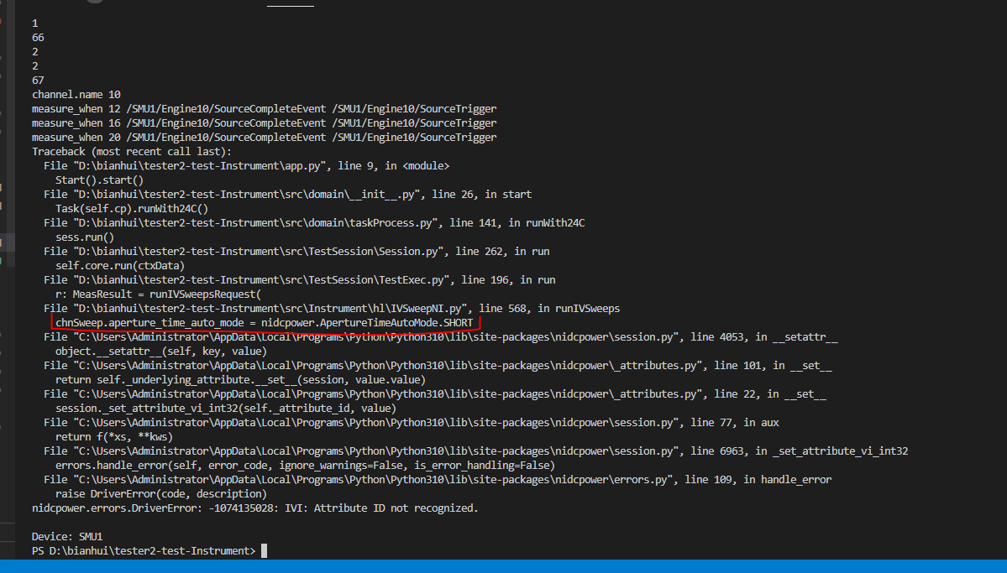
PXIe-4163 不支持aperture_time_auto_mode

Slide 5
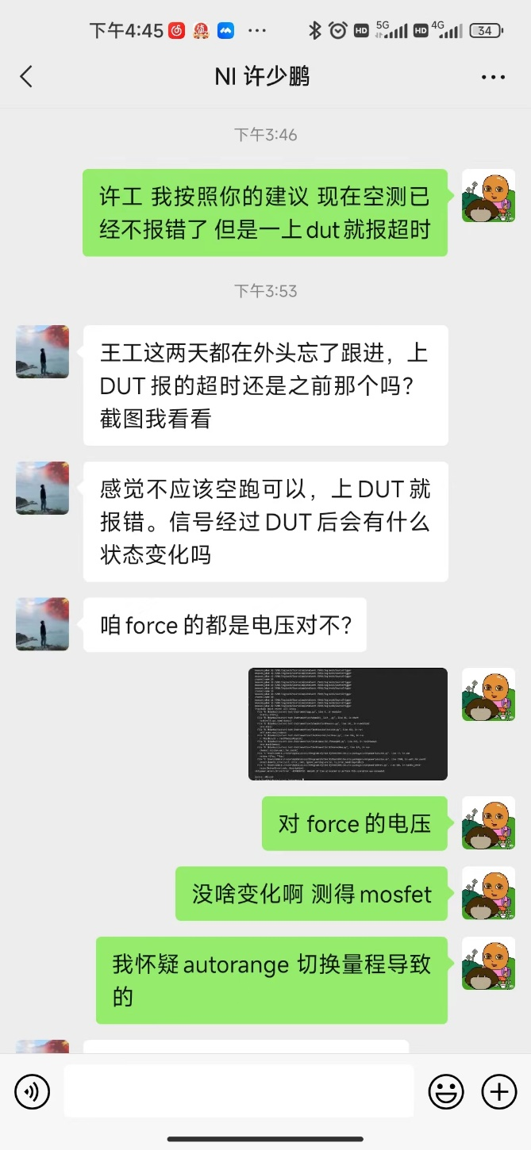
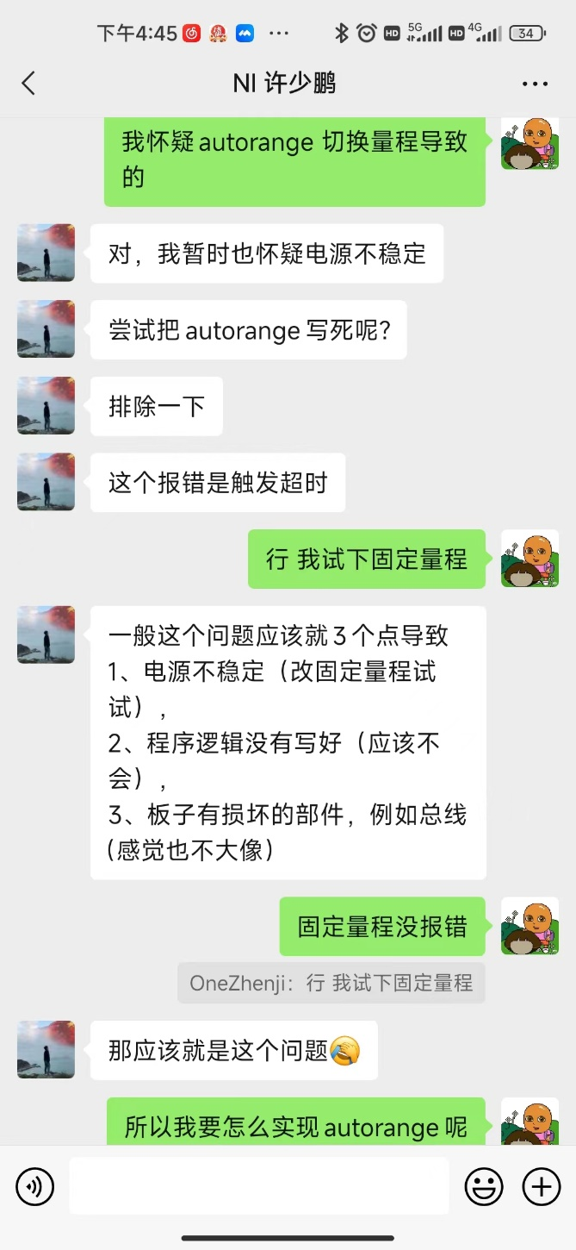
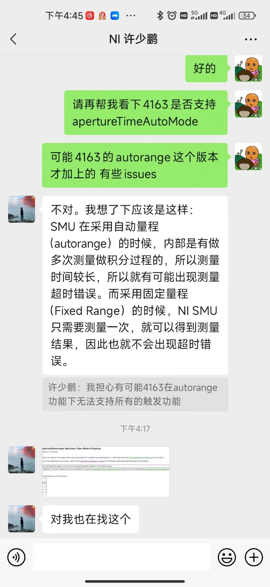
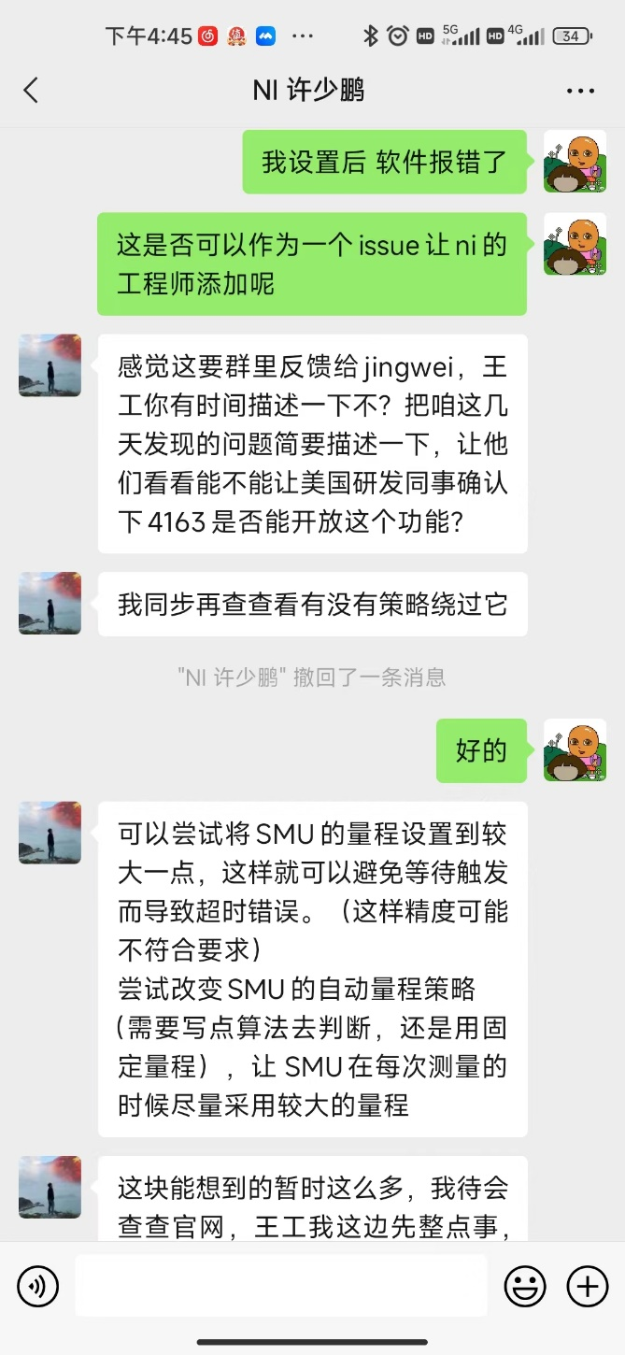
AE聊天记录

